Slide 1



AI: Tools that Actually Save You Time
A practical guide to AI tools for transportation engineers
Anna Klenke, PE | Department Manager – Bridge
Michael Kuhns, PE | Civil Engineer – Bridge
Notes:
Anna

Slide 2

AI tools that actually save you time
What we will get hands-on with today...
Microsoft Copilot
AI built into Outlook, Word, Excel, and PowerPoint, with enterprise data protection.
ChatGPT, Claude, Gemini
The other major assistants - plus powerful coding agents you can reach directly.
Prompt engineering
Simple habits that get you useful results on the first try.
Practical use cases
Everyday office work and research where AI saves real time - used safely.
Moving from curiosity to practical, everyday use of AI - focused on real tasks, better prompts, and time saved.
Notes:
Anna

Slide 3



Speaker Introduction – Anna Klenke
Background and Focus
Supports KYTC projects ranging from individual structures to large statewide programs and bridges.
Leads multidisciplinary teams across multiple offices and disciplines, with a focus on project delivery, coordination, and organization.
Applies AI to project controls, staffing management, meeting follow-up, and team coordination to improve productivity and keep complex projects organized.
What You Bring Today
Practical manager’s perspective on using AI-assisted workflows to boost efficiency and save time across teams
Deep familiarity with KYTC and expected quality. Draws the line and keep human engineering judgment and quality processes in the loop with AI
Demonstrated experience building AI-assisted workflows and agents for technical problem-solving
Notes:
Anna

Slide 4

Speaker Introduction – Mike Kuhns
Background and Focus
Bridge engineer specializing in digital delivery and emerging AI applications for bridge design workflows
Active contributor to Bridge Technology initiatives, supporting BIM, digital twin, and automation efforts across projects
Plays a key role in AI enablement within the bridge practice, including practical use of Copilot and internal tools
What He Brings Today
Practical insights on using AI tools to streamline engineering tasks (plan review, document processing, model generation)
Real-world perspective on when and how to apply tools like Copilot and other models effectively
Demonstrated experience in building AI-assisted workflows and agents for technical problem-solving
Notes:
Mike
17 years of Bridge design experience
Includes the whole breadth of bridge project details (roadway, H&H, E&S, Permitting, etc.)
5 years at MBI
Working with AI for the past 2 years
Broad experience with AI tools including agent creation and orchestration and use of local AI models

Slide 5

What we'll cover today
Copilot: Microsoft's answer to AI
Office apps, agents, and data protection
1
5 min
ChatGPT, Claude, Gemini
Access, coding agents, and protections
2
5 min
Prompt engineering fundamentals
Get useful results on the first try
3
5 min
Practical use cases
Office work, research, and safe habits
4
20 min
Notes:
Mike
Cover 4 main topics today:
Copilot – Microsoft’s AI solution -> Available across the entire Microsoft ecosystem (Windows, Office, Edge, web services, etc.)
Foundation Models – ChatGPT/Anthropic/Gemini -> the main AI players. You’ve probably heard about them in the news/online/your kids. Pushing the industry and the technology forward (MCP, invented by Anthropic didn’t exist 2 years ago)
Prompt Engineering – How we actually interact with the AI models. What we say and don’t say are extremely important.
Practical use cases – examples of things you can do with AI today, as soon as this presentation is over

Slide 6


Kentucky’s AI policy: the rules we work under
Senate Bill 4 - signed March 2025
Codified at KRS 42.731; creates an AI Governance Committee inside the Commonwealth Office of Technology
Agencies must route AI through COT approval before deploying it
CIO-126 - enterprise AI policy
Effective October 2025; sets acceptable uses of generative AI for executive branch employees
Protects the safety, privacy, and intellectual property of Commonwealth data
Read it alongside CIO-060, the acceptable use policy
Transparency - and human oversight
Agencies disclose where AI informs decisions affecting citizens
A human stays in the loop on consequential decisions
Citizens get a path to appeal an AI-influenced decision
What it means - for our KYTC work
Use approved, registered tools and keep sensitive project data out of anything else
Engineering judgment, review, and QC stay with the engineer
Rule of thumb: Kentucky permits AI use, with approval, disclosure, and a human accountable for the result.
Notes:
Mike
Kentucky has an AI Governance Committee w/in the Commonwealth Office of Technology (COT)
Office of the Chief Information Officer Enterprise Policy (CIO)
CIO-126: Artificial Intelligence Policy
- Effective 10-06-25
Must disclose when AI informs decisions that affect citizen and keep a Human-in-the-Loop (HitL)
Use approved and registered AI tools ony.
Engineering judgement, review, and QC stay with the engineer
Rule of thumb: Kentucky permits AI use, with approval, disclosure, and a human accountable for the result.

Slide 7


01
Copilot: Microsoft’s answer to AI
Office apps integration and enterprise data protection
Notes:
Mike
Copilot – Microsoft’s AI solution -> Available across the entire Microsoft ecosystem (Windows, Office, Edge, web services, etc.)
AI tool that most people likely have immediate access to both personally and professionally (though your organization may of course be different)

Slide 8
Copilot in your Office apps
Outlook - Email, calendar
Search and organize your inbox.
Schedule and set up meetings
Word - Documents
Summarize, correct, and rewrite
Change fonts and restyle formatting
Automated spell-check and edits
Excel - Spreadsheets
Writes formulas for you
Adjust and formats sheets
No VBA or Python support
PowerPoint - Slides
Create and update slides
Move text and objects across slides
Rule of thumb: Copilot works right inside the app you are already using.¹
Notes:
Mike

Slide 9
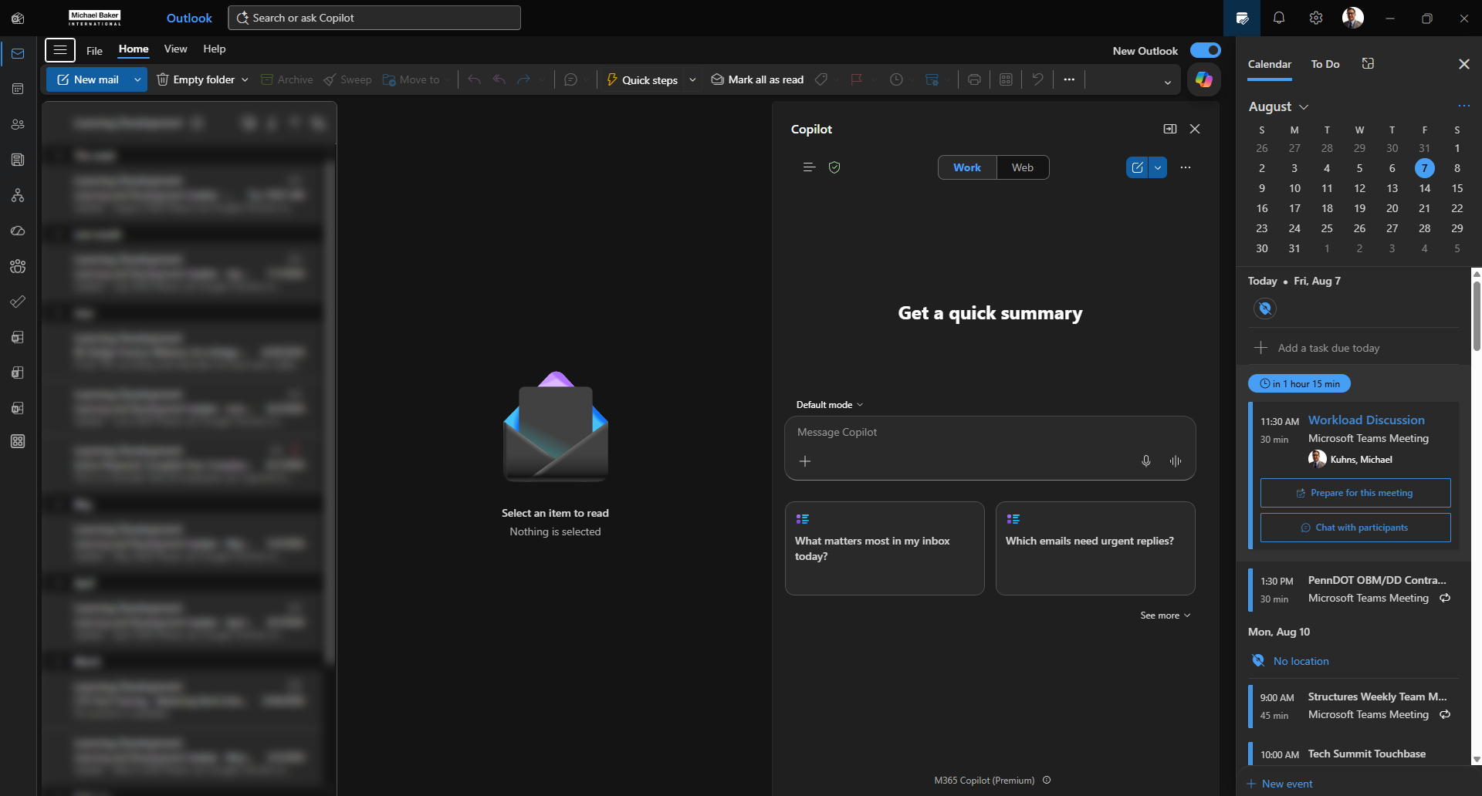

Outlook
Notes:
Mike

Slide 10

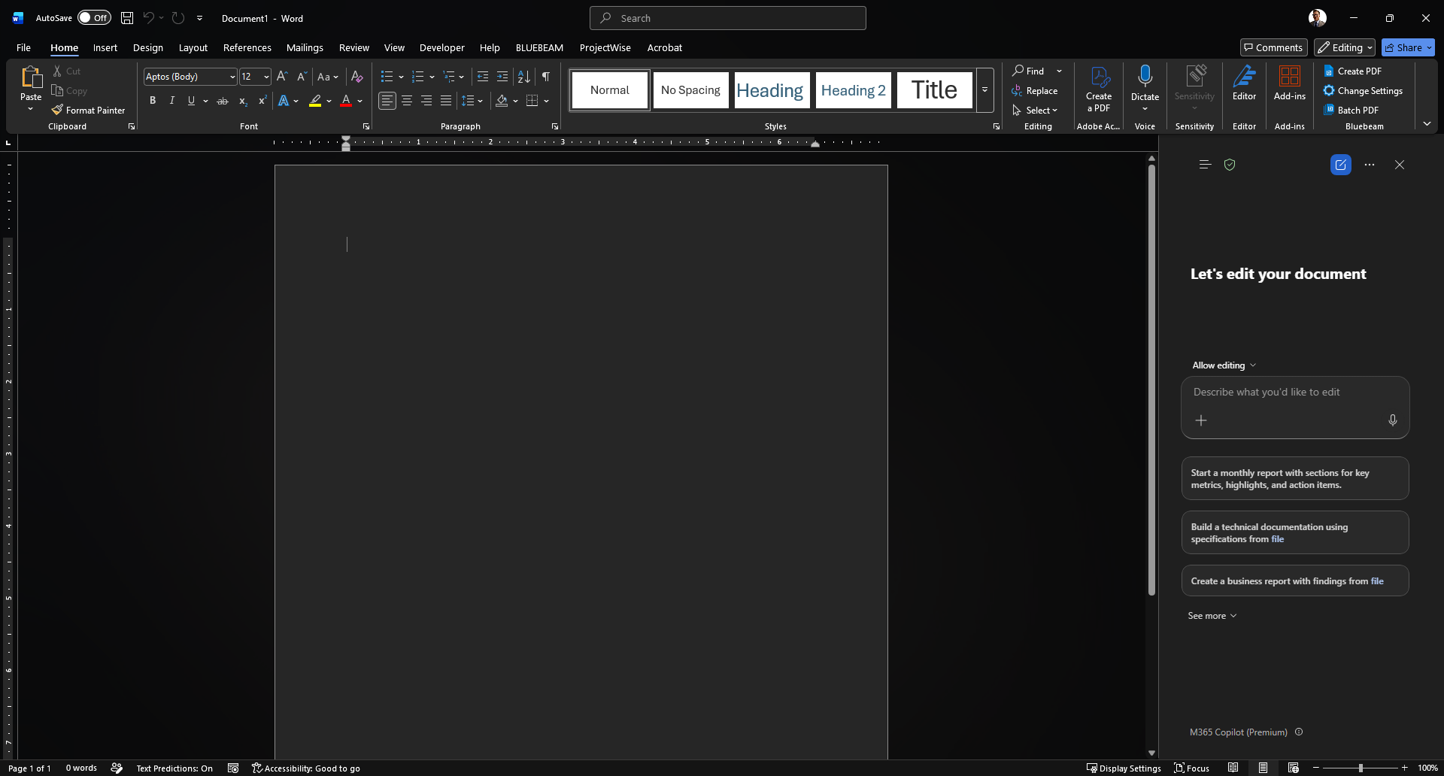

Word
Notes:
Mike

Slide 11
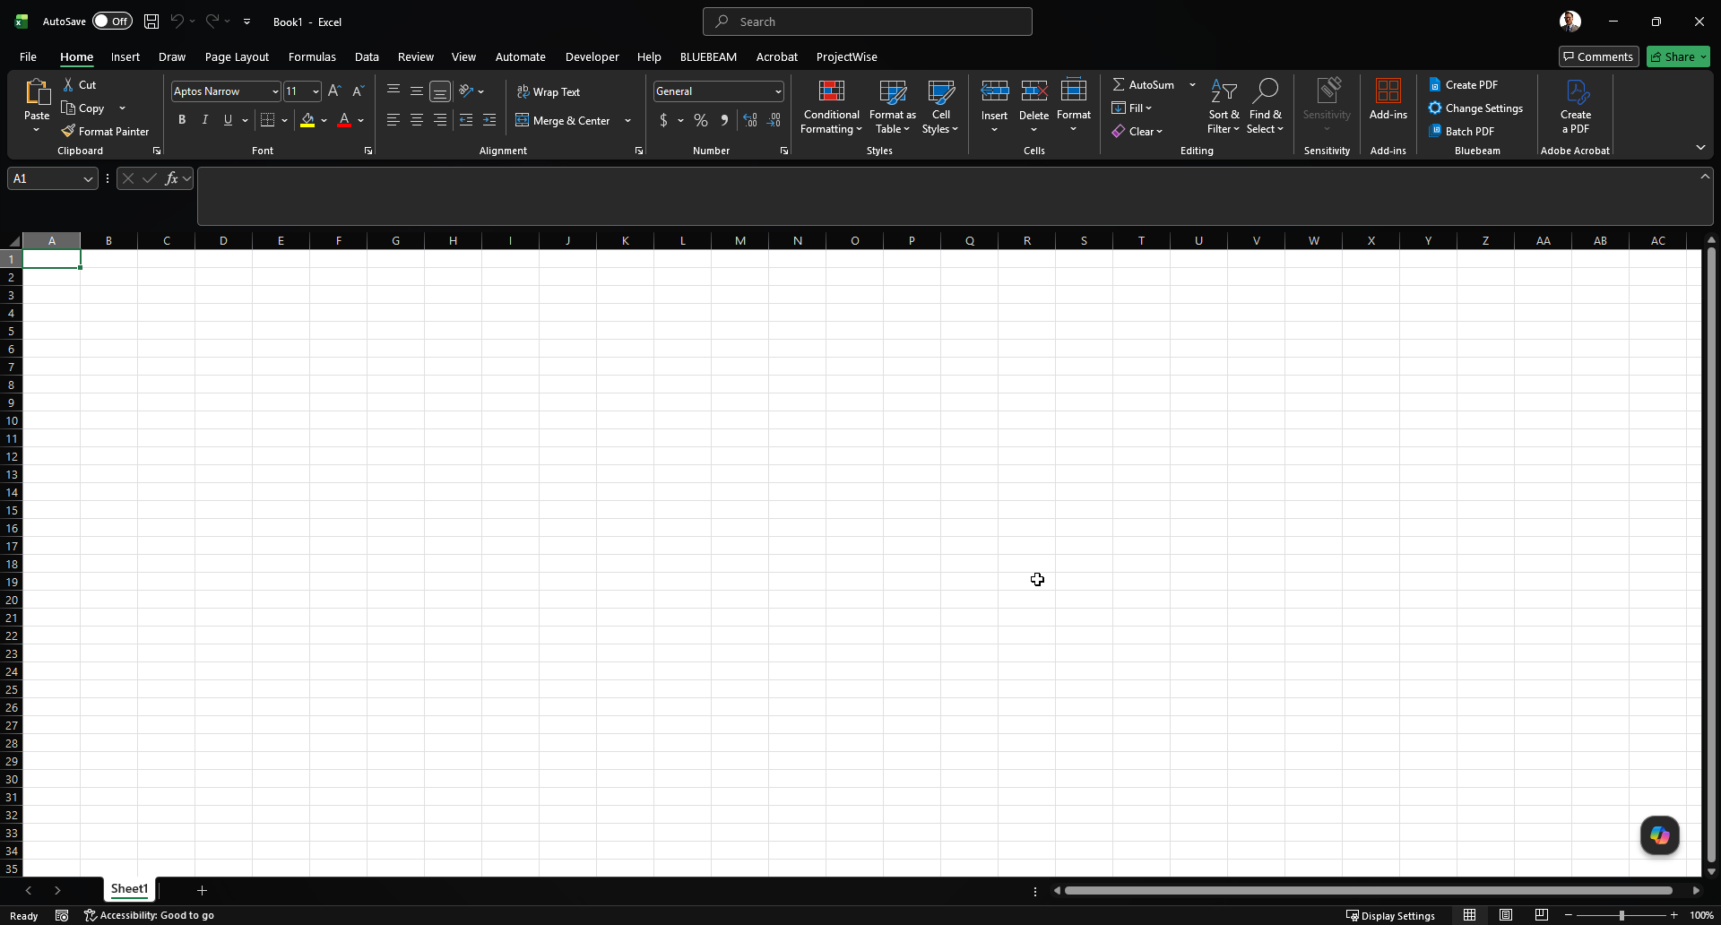
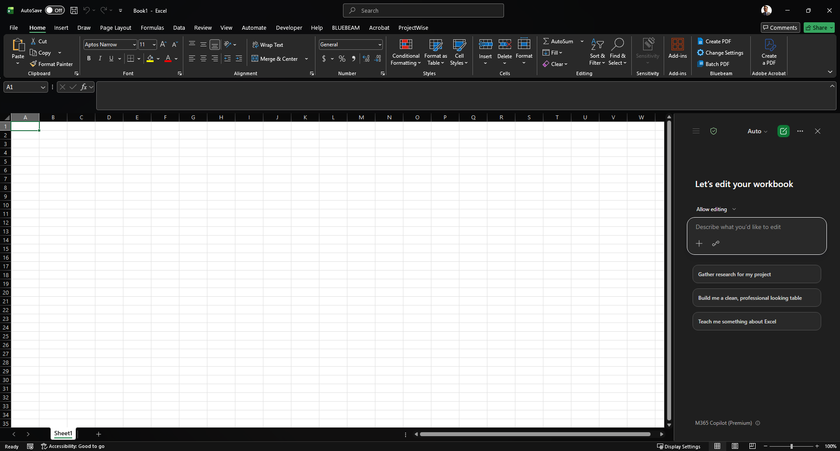
Excel
Notes:
Mike

Slide 12
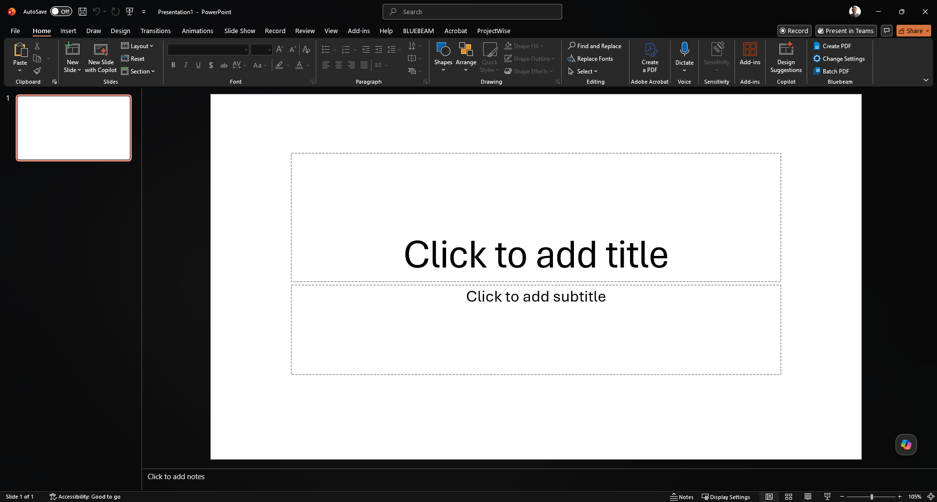
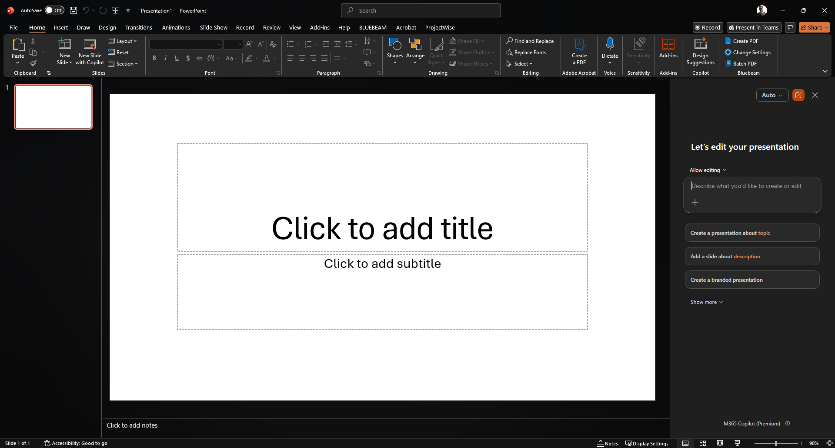
PowerPoint
Notes:
Mike

Slide 13
Microsoft 365 Copilot
What sets it apart
Available on web or desktop - same experience
Retains logs of your past conversations
Create purposeful agents for repeat tasks²
Connects across your Microsoft 365 apps
Grounded in your own work content
Purposeful agents
Your own AI, tuned to a task
Point it at your standards library
It answers only from what you provide
Set it up once, then share it
Reuse it any time, on demand
A powerful, but advanced topic.
Notes:
Mike

Slide 14

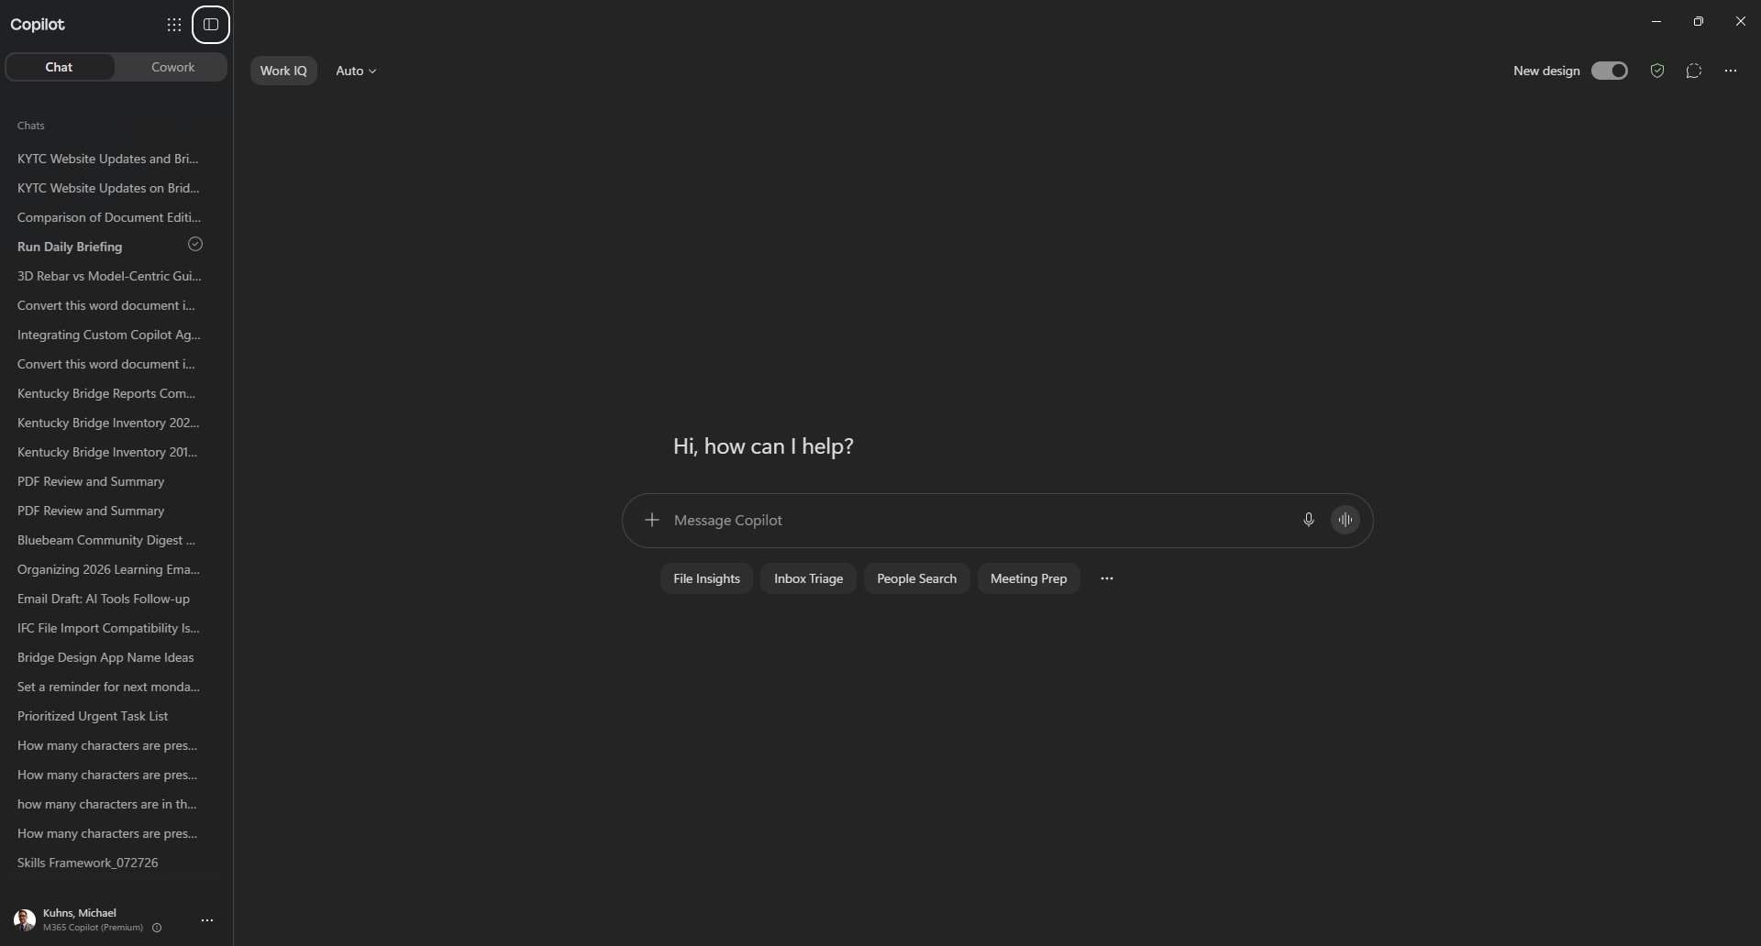
Microsoft 365 Copilot
Notes:
Mike

Slide 15
Enterprise Data Protection
Why it matters
Your prompts and files stay in your tenant³
Microsoft acts as your data processor
Your data is not used to train the models
Same enterprise terms as Microsoft 365
What you get
Protection built in
Covered by the Data Protection Addendum
Enterprise-grade privacy and security
Controls that meet compliance needs
Safe for day-to-day work content
Notes:
Mike
Enterprise Data Protection:
Your prompts and files stay within your “tenant” (your organization-specific file system/share)
Your prompts and data ARE NOT used to train AI models – keeps your information private and unable to be extracted from the next model release

Slide 16
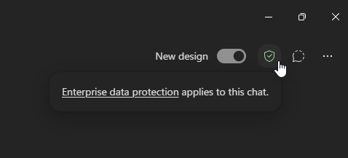
Enterprise Data Protection
From Microsoft:
Microsoft 365 Copilot Chat automatically provides Enterprise protection when logged in with work account.
Prompts, including added work content, and Copilot response ARE NOT used to train AI models.
Chat data in Microsoft 365 Copilot Chat is encrypted during the session
Notes:
Mike
- Green Shield is your indicator when working with Microsoft’s AI tools (Copilot)

Slide 17
Copilot at a glance
Your Microsoft AI
Copilot
One assistant across your email, documents, spreadsheets, and slides.
Reach for it to:
Draft and search across email and files
Build formulas, sheets, and slides
Create and run your own agents
Work protected by Enterprise Data Protection
Notes:
Mike
Ways to use Copilot:
Draft and search for emails and other files
Build formulas/sheets/slides
Here’s the secret:
COPILOT isn’t just a single model. It’s a harness that can use ChatGPT or Anthropic models, are your discretion. Use the best model for the job.

Slide 18
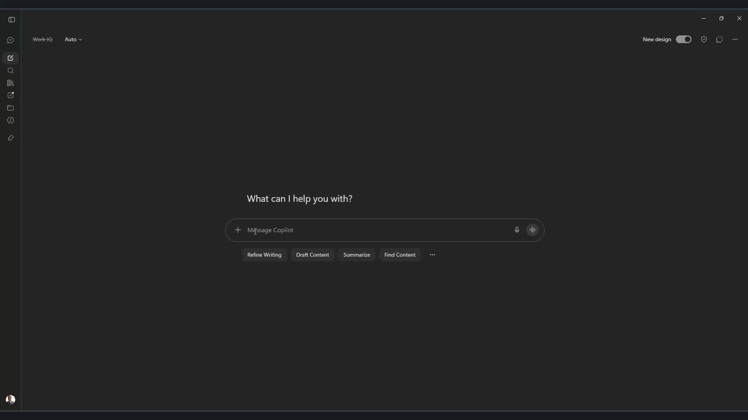
Notes:
Mike
PROMPT:
Create a brief description of Microsoft Copilot and how it can help transportation officials do their jobs
RESPONSE:
Microsoft Copilot is an AI-powered assistant that works within Microsoft 365 applications such as Outlook, Teams, Word, Excel, and PowerPoint. It uses advanced AI along with organizational data that users have permission to access to help answer questions, summarize information, generate content, analyze data, and automate routine tasks.
How Microsoft Copilot Can Help Transportation Officials
Transportation agencies manage large amounts of data, documents, plans, emails, and stakeholder communications. Microsoft Copilot can help by:
- Reducing administrative workload by drafting emails, meeting notes, reports, and presentations.
- Improving decision-making by quickly analyzing spreadsheets, project data, budgets, and performance metrics.
- Enhancing collaboration by summarizing Teams meetings, tracking action items, and helping staff stay aligned across departments and projects.
- Accelerating project delivery by helping prepare project documentation, review specifications, and generate first drafts of technical reports.
- Improving information access by allowing staff to ask questions in natural language and quickly find relevant files, policies, standards, and project information.
In summary: Microsoft Copilot acts as a digital assistant that helps transportation officials spend less time searching for information and completing routine tasks, allowing them to focus more on planning, infrastructure delivery, safety, and serving the public.

Slide 19
02
ChatGPT, Claude, Gemini
Best practices and pitfalls of major AI models
Notes:
Mike
The main Foundation models in the market
- A foundation model is one of the industry leading/cutting edge models from the leading AI companies. Pushes the technology and the markets forward. More capable.

Slide 20
ChatGPT, Claude, and Gemini
Three assistants you will meet outside the Microsoft world - each strong, each a little different in style and strengths.
ChatGPT
OpenAI's assistant - a versatile all-rounder.
Claude
Anthropic's assistant - strong writing and code.
Gemini
Google's assistant - tied into Google services and powerful image creator.
How to reach them
Directly, or through tools you already use.
Note: Most are reachable through services like Copilot - Gemini is the exception.
Notes:
Mike

Slide 21
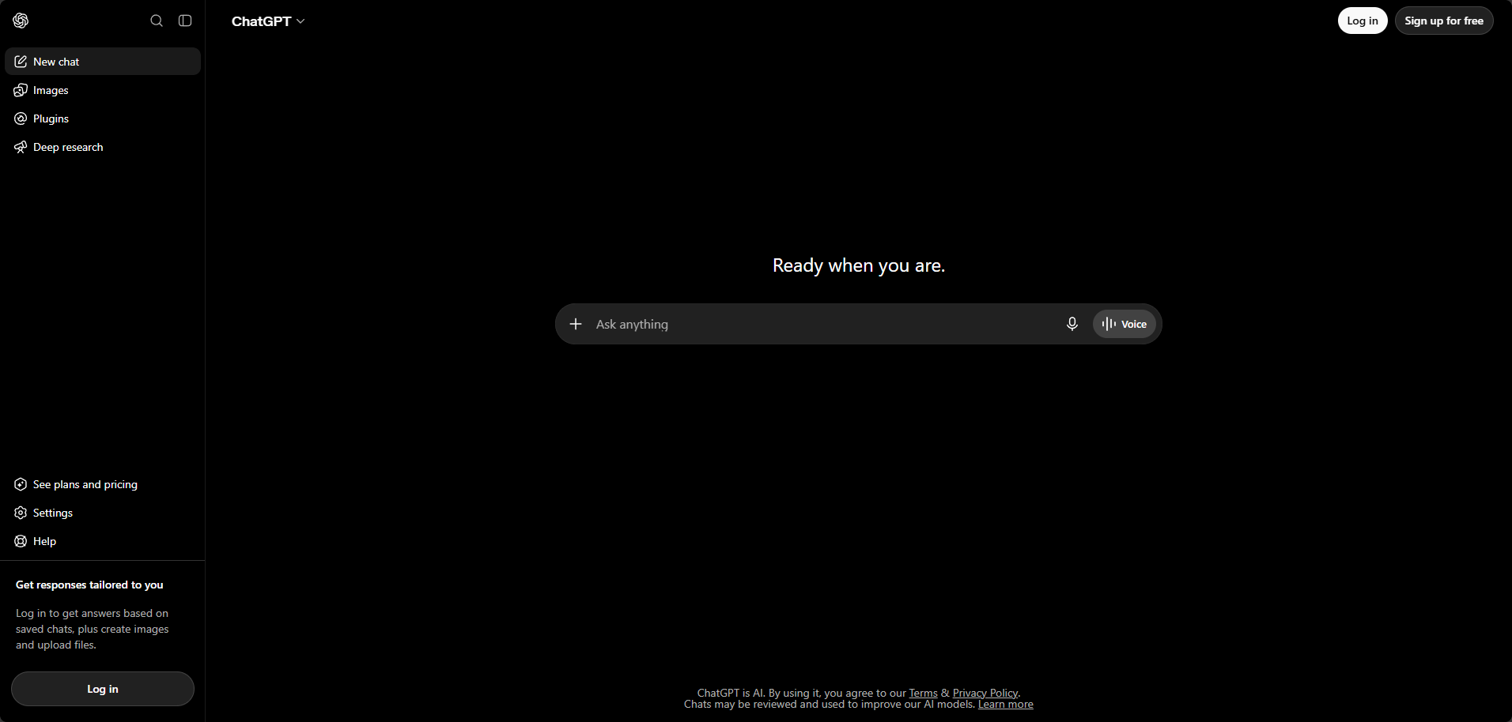
ChatGPT - OpenAI
Notes:
Mike

Slide 22
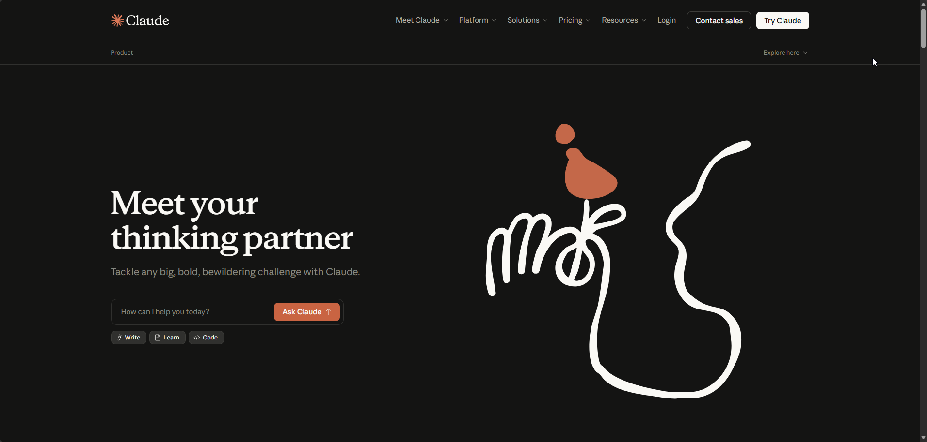
Claude - Anthropic
Notes:
Mike
- Need to have a login

Slide 23
Coding agents & enterprise protection
Powerful coding agents
Tools: Claude Code, OpenAI Codex, and Gemini CLI
Where: They run in your terminal and edit code agentically.
One prompt can build, refactor, and debug.⁴
Enterprise protections available at a cost
Default: Your prompts are not used to train the models.⁵
Control: You own your inputs and outputs.⁶
Available independently or via enterprise plans - with protections worth switching on.
Notes:
Mike
A major use case in engineering for the foundation models is code creation
Each company has their own version of powerful coding agents -> experts at writing code
Each company also provides Enterprise Protections at a price
Bespoke workflow. Would need to purchase for EACH model
Copilot Enterprise Protection: Applies to ALL the models you’re using w/in Copilot. Doesn’t extend to the Model providers own AI interface platforms.

Slide 24
Common pitfalls in business use
Confident but wrong
Risk: Models invent facts, citations, and code that look right.
Habit: Verify numbers, standards, and sources before they leave your desk.
Sensitive data in the wrong tool
Risk: Client, personnel, or project data pasted into a consumer account.
Habit: Use approved, enterprise-protected tools for anything non-public.
No engineer in the loop
Risk: Output accepted as final without review, QA, or a licensed sign-off.
Habit: Treat AI as a first draft - you still own the deliverable.
Missing context and stale knowledge
Risk: Generic answers that ignore current specs, standards, and project files.
Habit: Ground the prompt in your own documents and state the date and scope.
Right tool, protected data, verified output - that is what keeps AI useful at work.
Notes:
Mike
COMMON PITFALLS
Confident responses that are incorrect. Even when repeatedly asked to check/verify.
- Verify information independently. Provide concrete references explaining what is incorrect. Start a new chat
Using Sensitive data outside of an Enterprise Protection environment
- Use Enterprise Protection only
Trusting output without reviewing it for accuracy/completeness first
- Treat AI Output as a first draft
Missing Context and stale knowledge -> Generic answers, missing outputs, not providing artifacts (PDFs, documents, images) when requested.
- Start a new chat

Slide 25
03
Prompt engineering fundamentals
Get useful results on the first try
Notes:
Mike
What we say and don’t say to the model matters

Slide 26
Prompt engineering fundamentals
Less is more
Short, direct prompts usually beat long ones.
Cut the filler
Use focused language and drop extraneous words.
Be task-specific
Aim at one clear task; avoid being too broad.
Skip the small talk
Do not chat with it like you are texting a friend.
Notes:
Mike
Less is more -> Keep prompts short but specific
Cut the filler -> use focused words, avoid non-descriptive text
Be task-specific – Focus on clear task, “change a single variable”, don’t get too broad
Despite its appearance, it is not like chatting/texting with a friend. It’s using probabilistic word choice based on the patterns available in it’s training data.

Slide 27
Habits that pay off
Save what works
Track and reuse the prompts that give you good results.
A small prompt library beats starting from scratch every time.
Expect some variation
The same prompt will not always give the same answer
A fresh chat can produce different output
Example: “Reformat my 100 tabs”
Lock in the wording once it works
Start new conversations
Chat windows can only contain so much information
Quality of responses drops over time
Referred to as the “Context Window”
Keep conversations short and direct
Ask AI to create a prompt for the next, new chat
Notes:
Mike
Save what works
Most provides track the chats, but if you do enough it gets hard to parse
Keeping your own documentation of useful prompts makes it much faster to find and reuse what you need
The same input will not always yield the same output: “What is the capital of France?” Paris 94% of the time (ChatGPT 3.5)

Slide 28
Common prompt pitfalls
Small habits quietly derail your results - watch for these.
Too broad
Asking for everything at once.
Too chatty
Padding the prompt with small talk.
Too vague
No context, format, or audience.
Expecting sameness
Assuming identical output every run.
Tighten the prompt and you tighten the result.
Notes:
Mike
Prompting pitfalls similar to overall AI use pitfalls
Too broad (be specific)
Too chatty (be succinct)
Too vague (be descriptive)
Expecting sameness (don’t. Expect SIMILAR results)

Slide 29
04
Practical use cases
Realtime demonstrations of useful tools
Notes:
Mike

Slide 30
Where it actually saves you time
Office work and research
1
Email
Draft, summarize, manage the inbox, and set up meetings (not Teams calls).
2
Documents
Review, summarize, and extract key information.
3
Presentations
Build slides fast when given a template and an outline.
4
Research
Parse documents you provide; compare and contrast them.
5
Web search
Get specific, summarized results with sources.
Notes:
Mike
A couple of specific daily workflow-type tasks using Copilot

Slide 31
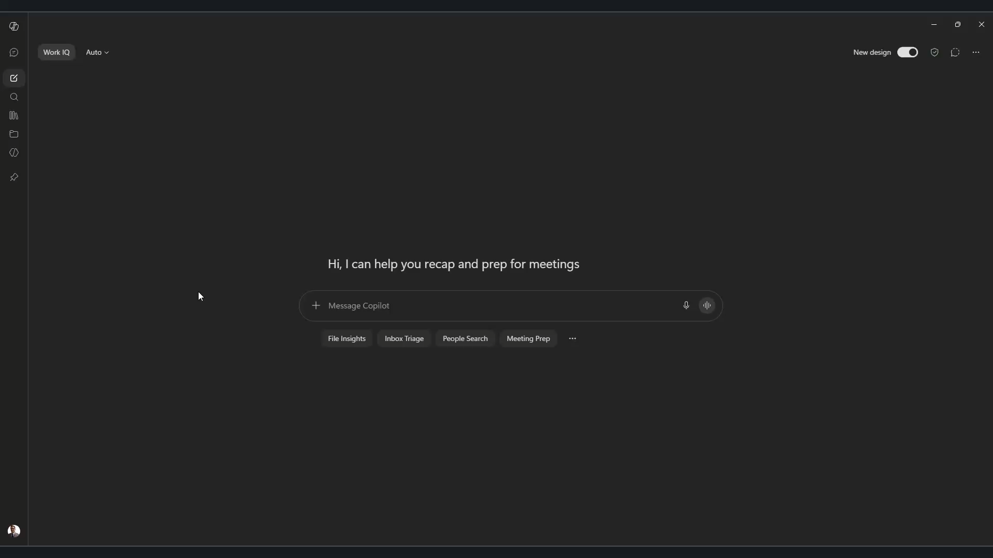
Notes:
Mike
Email Creation example
Prompt: Draft an email to Anna Klenke
Subject: AI: Tools that Actually Save You Time Follow-up
Body: Hi Anna,
Lets schedule a call next week after the conference to review the slides and any questions or conversations we had with conference attendees with the intent of improving the presentation and its delivery

Slide 32
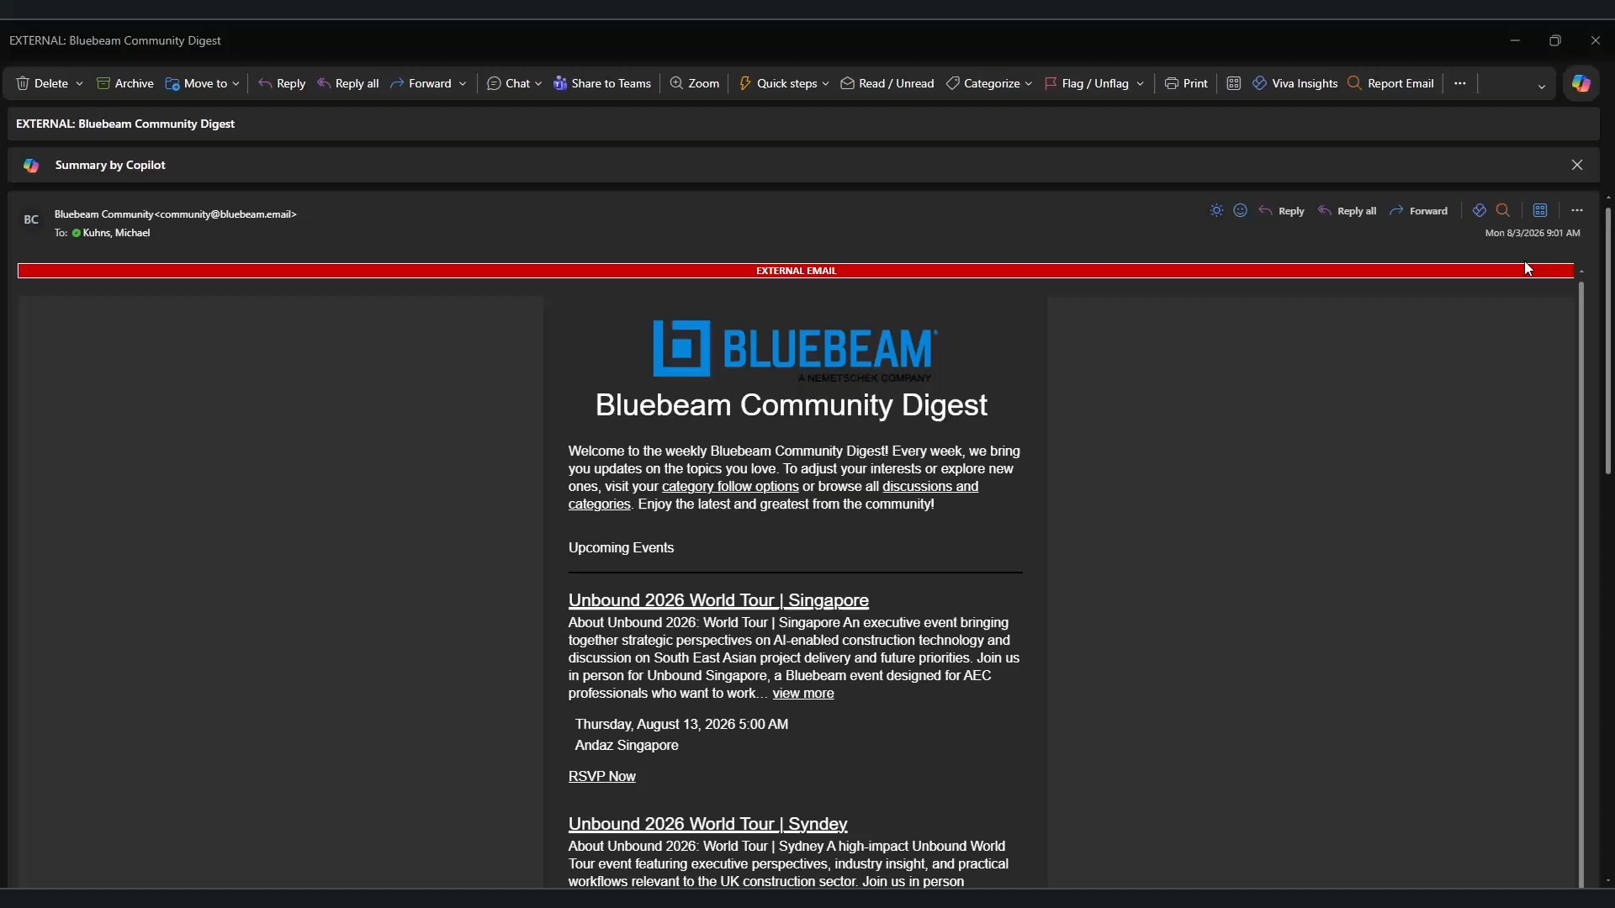
Notes:
Mike
Summarize email example
Use Copilot directly in the email.
Use a pre-provided prompt: Summarize this email.

Slide 33
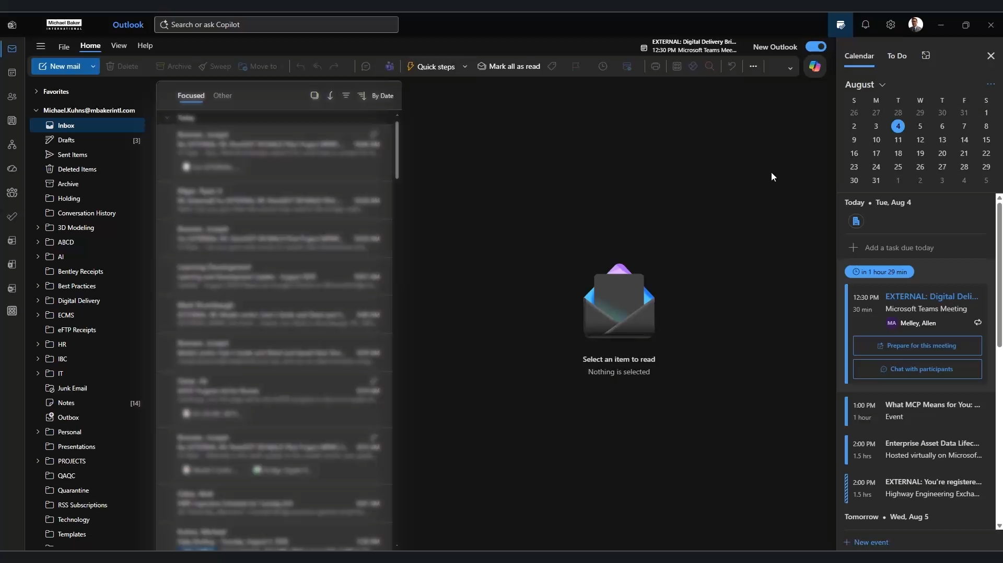
Notes:
Mike
Organize inbox example
Prompt: Create a new folder called “Learning Development” and move all Learning Development emails that I received in 2026 into that folder from the inbox

Slide 34
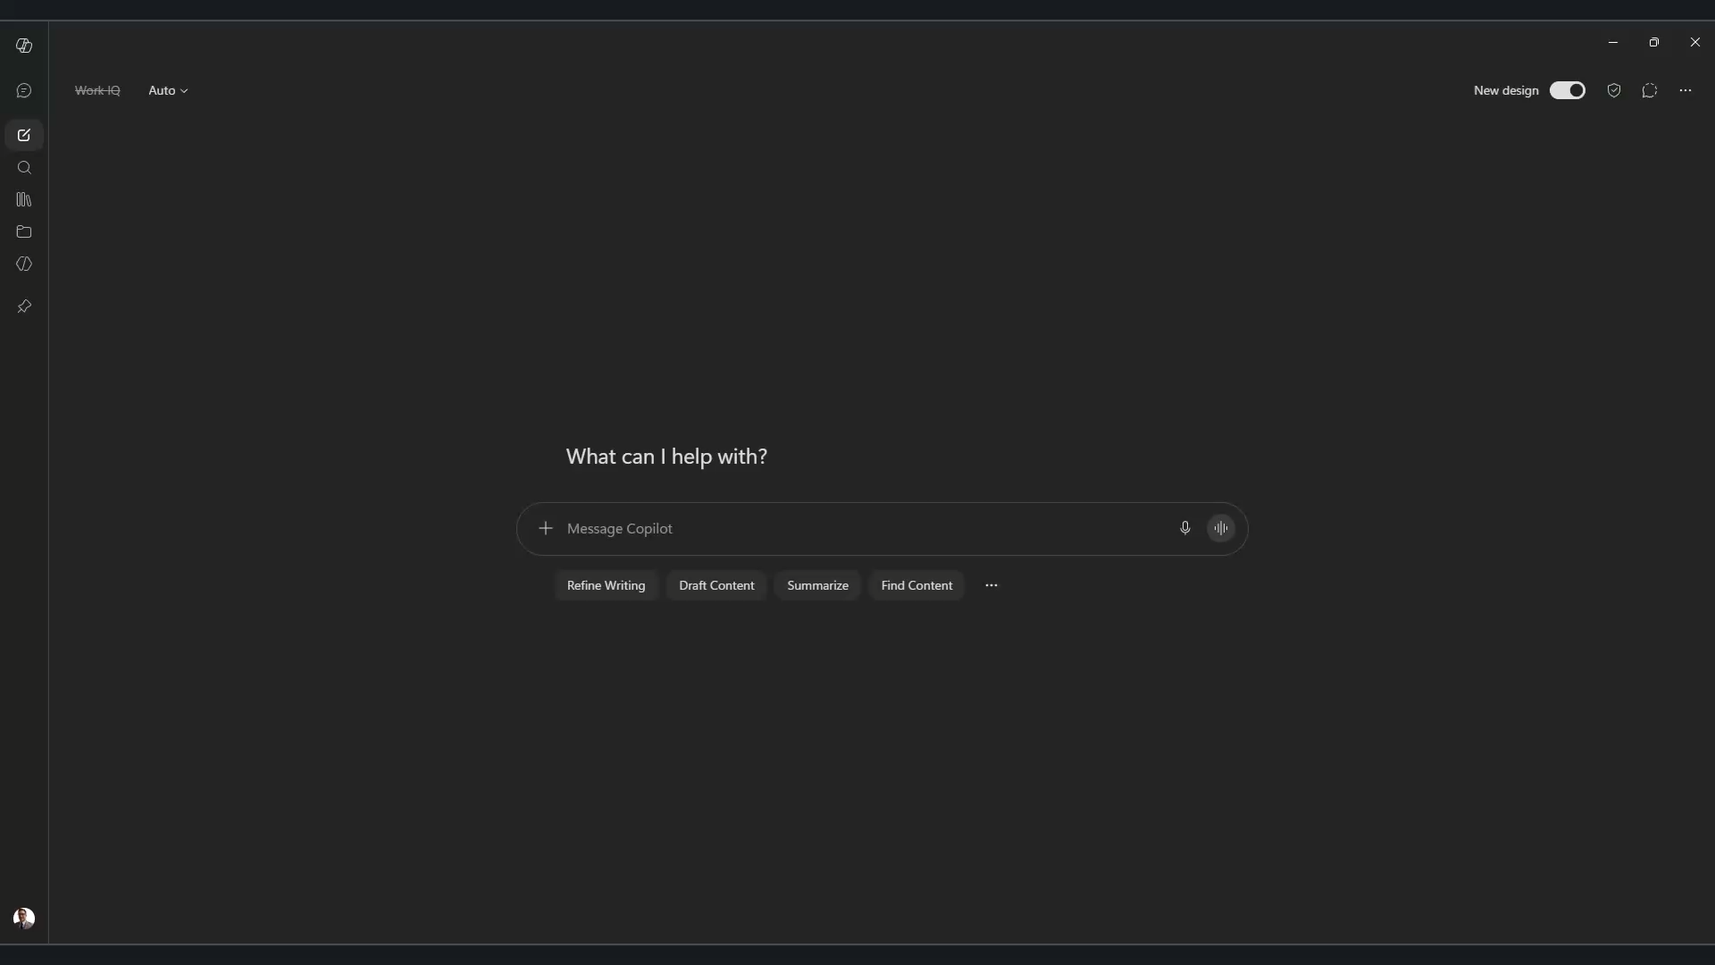
Notes:
Mike
Review and Summarize document example
Attached KYTC Division 600 – Structures and Concrete Specifications (2026)
Prompt: Review and summarize the attached PDF

Slide 35
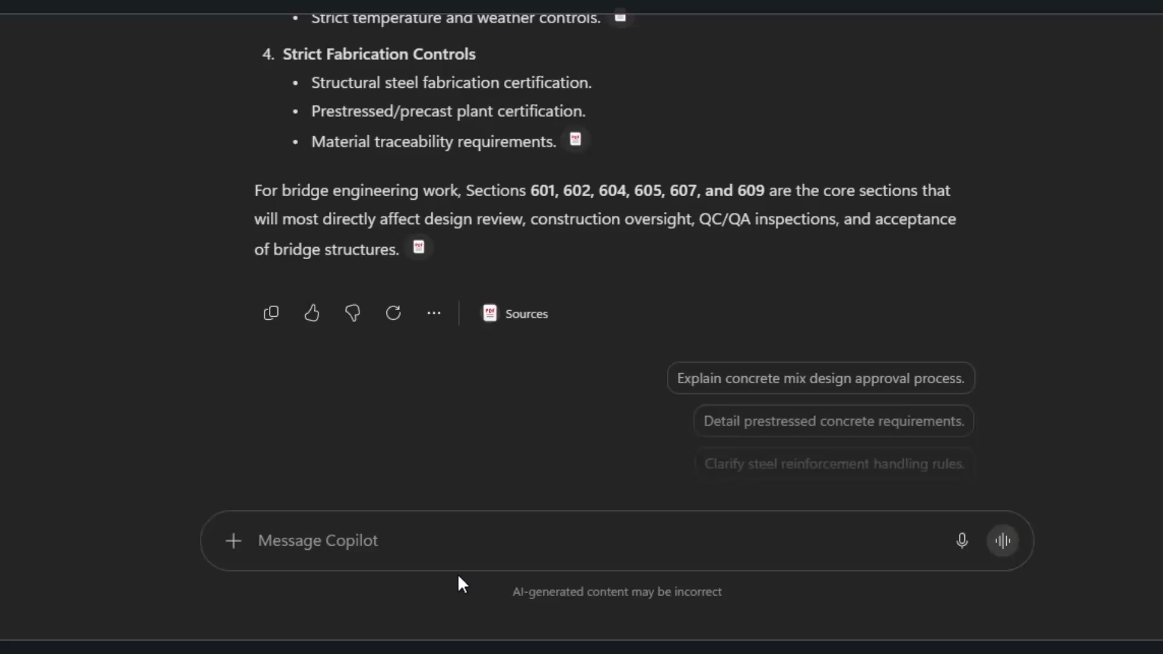
Notes:
Mike
Extract information from documents example
- Working with KYTC Division 600 – Structures and Concrete Specifications (2026)
Prompt: From the document, pull the different classes of concrete identified and relevant information or each class including things like compressive strength

Slide 36
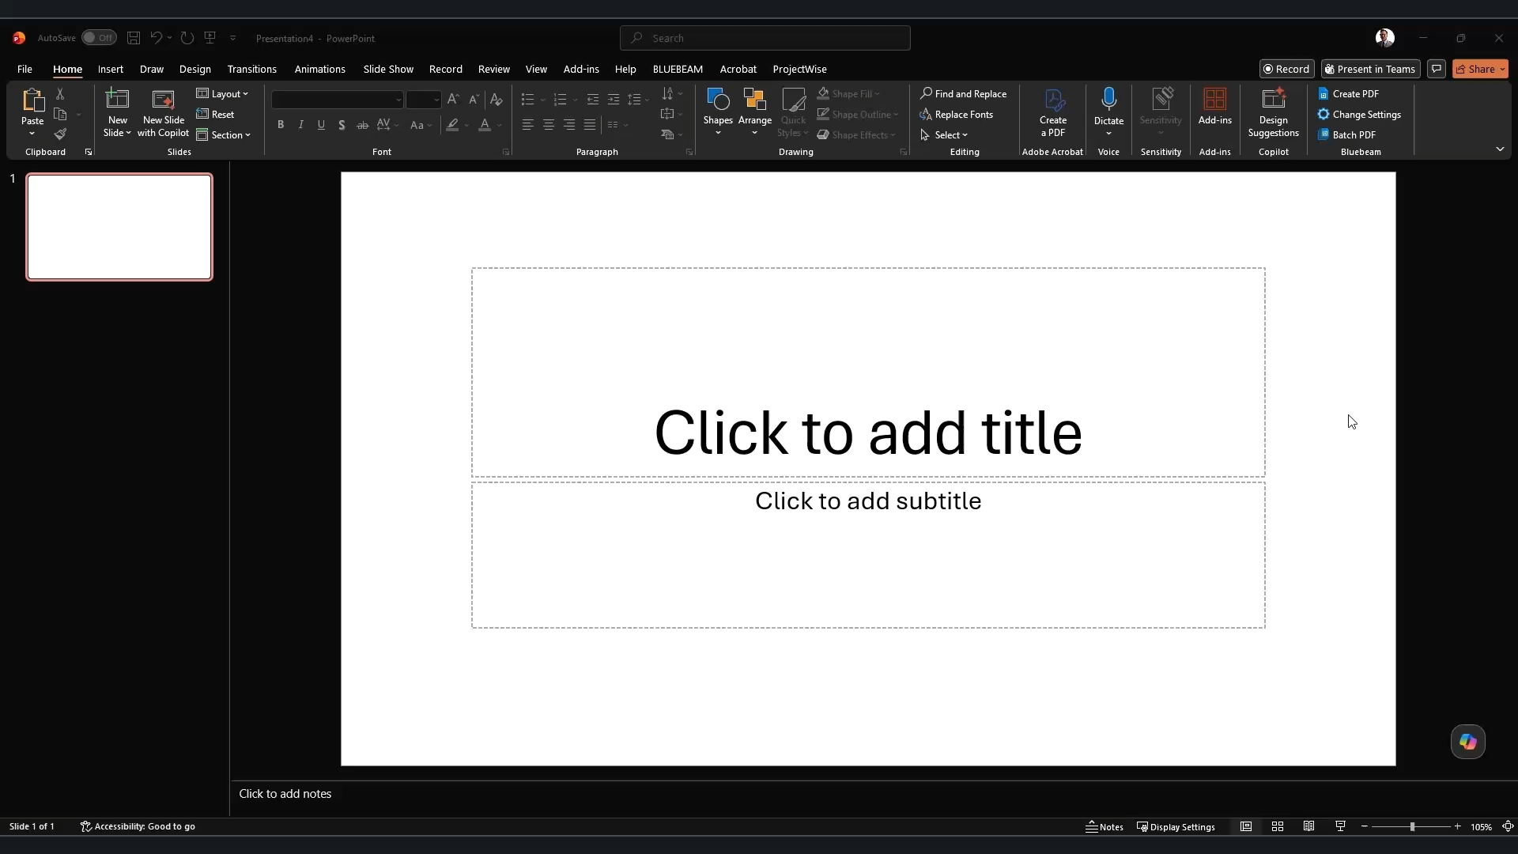
Notes:
Mike
PowerPoint Creation Example
Prompt: Create a presentation on the three oldest surviving covered bridges in Kentucky, information pasted below. use the attached template PPTX file for the slide backgrounds, styling, and themes. Pull one relevant image of each bridge from the internet, but only if images are in the Public Domain or released under a Creative Commons license. If none are available, simply indicate somewhere on the slides a photo could not be found. Limit one slide per bridge.
Provided a PPTX file as a template and supporting information (pasted right into the chat)
Output provides summary of what was done. Also informs user that images could not be sourced, but placeholder boxes added to slides.

Slide 37
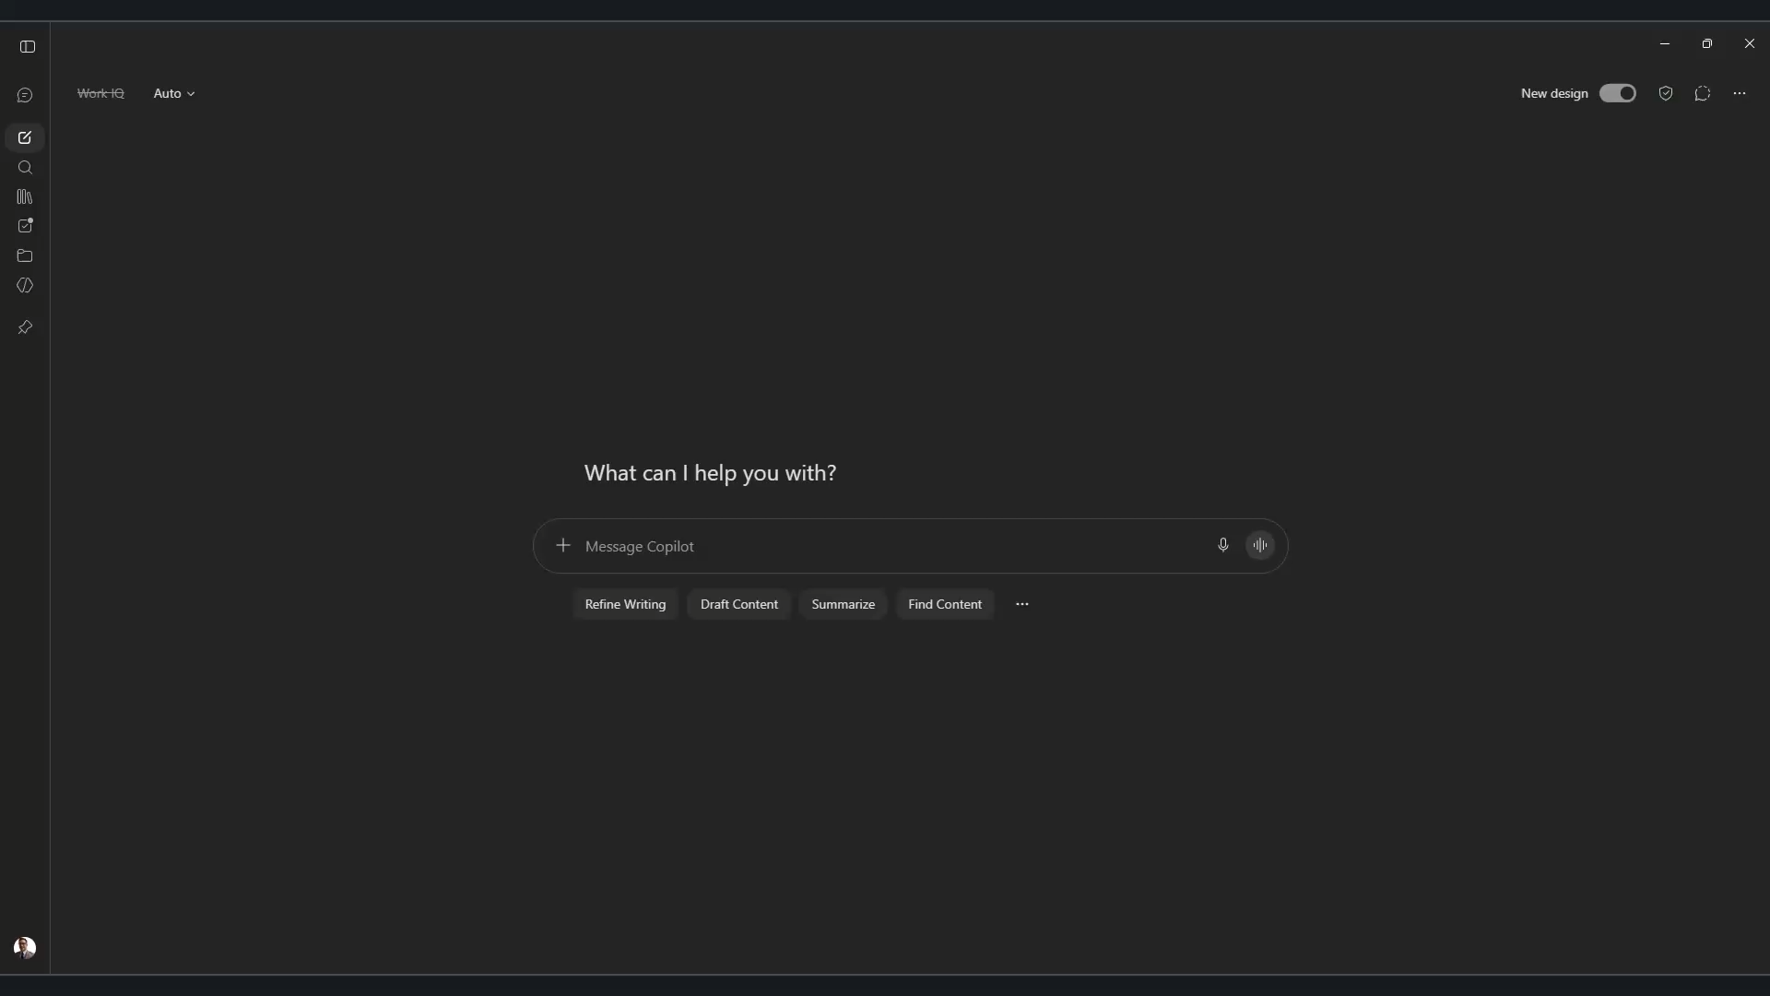
Notes:
Mike
Document Research and comparison example
Comparing KYTC Division 600 – Structures and Concrete Specifications (2026) and KYTC Division 600 – Structures and Concrete Specifications (2019)
Prompt: Create a high-level overview comparing the two different editions of the same document. Identify the major differences and present them in a table as output.
Provides the topic/area of focus in the manuals and what each manual says about it. Provides a column on the significance of the difference. Then provides an easily readable Executive Summary at the end.

Slide 38
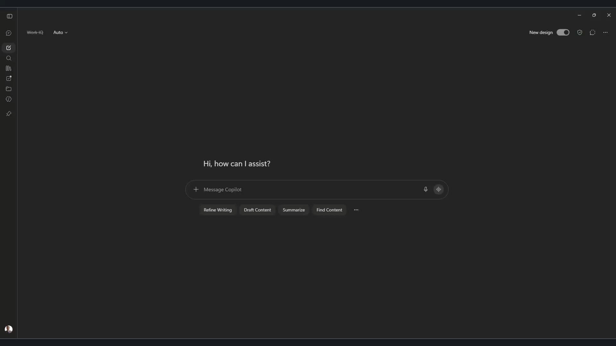
Notes:
Web Search Example
Prompt: Create a list of the most recent updates to the KYTC website. Identify the page as well as whether it is directly, indirectly, or not at all related to bridge design and analysis.

Slide 39
Additional Prompt Ideas
Notes:
Anna

Slide 40
Prompt ideas: Meetings
Turn meeting noise into decisions, owners, and dates.
Summarize
“Summarize this meeting into key decisions, action items, owners, and due dates.”
Plan ahead
“Create an agenda for next week’s meeting based on these notes.”
Probe
“What follow-up questions should I ask after this meeting?”
Spot trouble
“Identify risks, unresolved issues, and next steps from these notes.”
Paste the notes, ask for the decisions - not a recap.
Notes:
Anna

Slide 41
Prompt ideas: Email management
Get through the inbox without reading every thread.
Brief me
“Summarize the last 20 emails on this topic into a one-page briefing.”
Draft it
“Draft a response that is professional, concise, and action-oriented.”
Triage
“Tell me what emails require my attention today and why.”
Tighten
“Rewrite this email to be clearer and shorter without changing the message.”
You still hit send - the judgment stays yours.
Notes:
Anna

Slide 42
Prompt ideas: Project management
Keep status, risk, and follow-through in one place.
Status update
“Create a project status update from the information below.”
Risk scan
“Identify schedule, budget, and scope risks from these meeting notes.”
Build a tracker
“Turn these action items into a tracker with owners and due dates.”
Look ahead
“What am I missing that could become a problem later?”
Great for the update you keep pushing to tomorrow.
Notes:
Anna

Slide 43
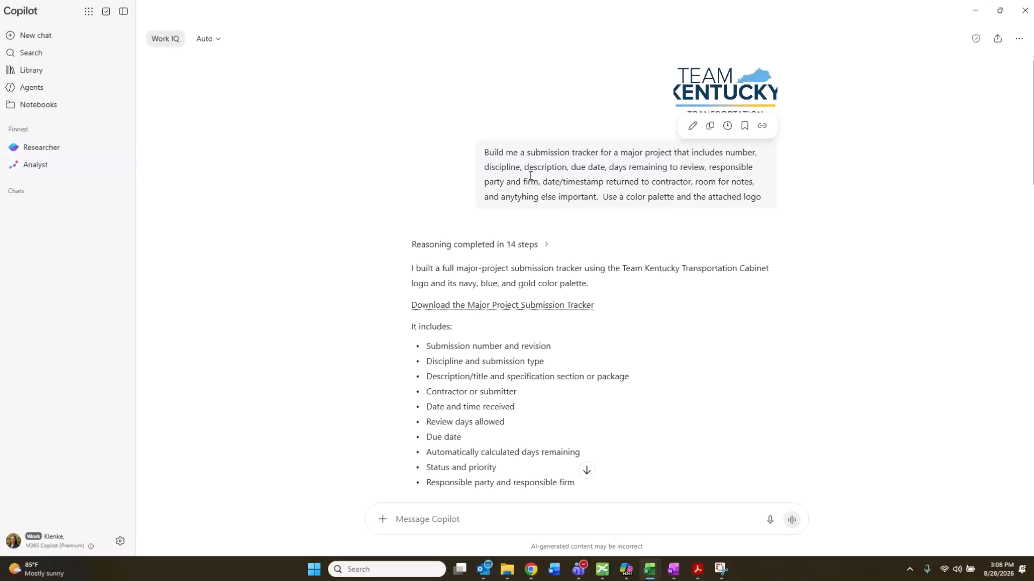
Notes:
Anna

Slide 44
Prompt ideas: Brainstorming
Use it as a thinking partner, not an answer machine.
Go wide
“Generate 10 ideas to improve this process.”
Push back
“Play devil’s advocate and identify weaknesses in this approach.”
Client lens
“What questions would a client likely ask about this idea?”
Blind spots
“Suggest options I have not considered.”
Ten mediocre ideas often shake loose one good one.
Notes:
Anna

Slide 45
Prompt ideas: Personal productivity
Point it at your own workload first.
Prioritize me
“Organize my workload into urgent, important, and can-wait categories.”
Make a plan
“Create a plan to finish these tasks by Friday.”
Highest value
“Estimate which activities provide the highest value for my time.”
Offload
“What could I delegate, automate, or eliminate?”
The fastest win is usually the work you stop doing.
Notes:
Anna

Slide 46
More ways to try it
Prompt examples
Job shadow – “Create an itinerary for a senior job shadow that’s 15 hours.”
Graphics – “Create a flyer for our upcoming holiday party.”
Staff management – “Based on these project schedules, build a workload forecast for each team member for the next eight weeks and highlight staffing conflicts.”
Where else it helps
Match staff to project needs
Forecast hiring requirements
Recommend training courses
Generate mentoring topics
Employee onboarding
Project assignment matrix
Everyday asks
Search for that ancient email I can never find
Draft my weekly email
Build me a schedule to hit this deadline
Notes:
Anna

Slide 47
Tips to use AI well
Four habits to keep
Always validate the output yourself - models can report errors or hallucinate.⁷
Keep a Human in the Loop (HitL) on anything that matters.
Aim it at narrow, well-defined tasks - not everything at once.
Start a new chat when you switch topics.
Trust, but verify - you own the final answer.
Notes:
Anna

Slide 48
Thank you - now go save some time.
Questions? Let's keep the conversation going.
Anna Klenke • Department Manager – Bridge • Anna.Klenke@mbakerintl.com
Michael Kuhns • Civil Engineer – Bridge • Michael.Kuhns@mbakerintl.com

Slide 49
References
Sources cited in this presentation
[1] Microsoft, "Copilot Chat embedded in Word, Excel, PowerPoint, and Outlook," Winbuzzer, 2025. https://winbuzzer.com/2025/09/16/microsoft-embeds-copilot-chat-directly-into-word-excel-and-other-365-apps-xcxwbn/
[2] Microsoft Learn, "Agent Management Essentials for Microsoft 365 Copilot." https://learn.microsoft.com/en-us/microsoft-365/copilot/agent-essentials/agent-essentials-overview
[3] Microsoft Learn, "Enterprise data protection in Microsoft 365 Copilot and Microsoft 365 Copilot Chat." https://learn.microsoft.com/en-us/microsoft-365/copilot/enterprise-data-protection
[4] DeployHQ, "Claude Code vs Codex CLI vs Gemini CLI (2026 Comparison)." https://www.deployhq.com/blog/comparing-claude-code-openai-codex-and-google-gemini-cli-which-ai-coding-assistant-is-right-for-your-deployment-workflow
[5] OpenAI, "Enterprise privacy at OpenAI," 2026. https://openai.com/enterprise-privacy/
[6] Curionic, "ChatGPT vs Claude vs Gemini: What Their Privacy Policies Actually Say," 2026. https://www.curionic.net/2026/07/chatgpt-vs-claude-vs-gemini-privacy-policy-data-comparison-2026.html
[7] A. Alansari and H. Luqman, "A Comprehensive Survey of Hallucination in Large Language Models," arXiv:2510.06265, 2025. https://arxiv.org/html/2510.06265v1

Slide 55
Copilot in your Office apps
Outlook & Word
Email, calendar, and documents
Outlook: search and organize your inbox
Outlook: schedule and set up meetings
Word: summarize, correct, and rewrite
Word: change fonts and restyle formatting
Word: automated spell-check and edits
Excel & PowerPoint
Spreadsheets and slides
Excel: writes formulas for you
Excel: adjusts and formats sheets
Excel: note - no VBA or Python here
PowerPoint: create and update slides
PowerPoint: move text and objects across slides
Rule of thumb: Copilot works right inside the app you are already using.¹

